Slide 1

Limb-girdle muscular dystrophy(LGMD)
Introduction
Limb-girdle muscular dystrophy refers to a large group of muscle disorders that causes weakness of the muscles in the limbs (legs and arms) and girdle area (hips, pelvis, abdomen) Like other muscular dystrophies, limb-girdle can affect other body systems, such as the heart in some instances.
As the disease progresses, limb-girdle muscular dystrophy can also cause weakness of the breathing and swallowing muscles.

Slide 2
Limb-girdle muscular dystrophy (LGMD)
Clinical manifestation /Symptoms
Toe walking, or walking on the balls of the feet
Walking with a waddling gait
Inability to rise from a squatting position without using the arms for leverage
Difficulty running
Abnormal curvature of the spine, such as lordosis and scoliosis. Learn more about scoliosis.
Joint stiffness

Slide 3
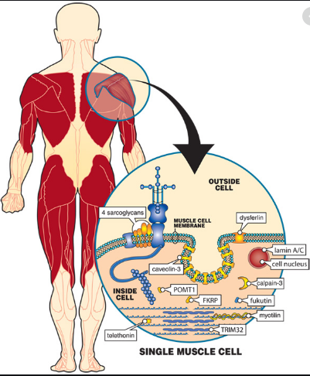
Limb-girdle muscular dystrophy (LGMD)
Clinical manifestation /Symptoms

Slide 4
Limb-girdle muscular dystrophy (LGMD)
Causes
The various forms of limb-girdle muscular dystrophy are caused by mutations in many different genes. These genes provide instructions for making proteins that are involved in muscle maintenance and repair.

Slide 5
Limb-girdle muscular dystrophy (LGMD)
Inheritance Pattern
Limb-girdle muscular dystrophy can have different inheritance patterns. Most forms of this condition are inherited in an autosomal recessive pattern, which means both copies of the gene in each cell have mutations.
Several rare forms of limb-girdle muscular dystrophy are inherited in an autosomal dominant pattern

Slide 6
Limb-girdle muscular dystrophy (LGMD)
Gene Panel
ANO5, CAPN3, CAV3, DES, DNAJB6, DYSF, FKRP, FLNC, HNRNPDL, ISPD, LMNA, MYOT, PNPLA2, SGCA, SGCB, SGCD, SGCG, TCAP, TRIM32, TTN
No of Genes : 20
Sample Type : EDTA-blood sample - 4 ml
TAT : 6 Weeks
Methodology : NGS

Slide 7
Diagnostic Tests

Slide 9
Management

Slide 10
Limb-girdle muscular dystrophy
Reference
https://ghr.nlm.nih.gov/condition/limb-girdle-muscular-dystrophy#genes https://www.mda.org/disease/limb-girdle-muscular-dystrophy/causes-inheritance
https://stanfordhealthcare.org/medical-conditions/brain-and-nerves/limb-girdle-muscular-dystrophy/causes.html

